Slide 1
Dynamic programming: More fun!
David Kauchak CS 140 – Spring 2023

Slide 2
Admin
Assignment 5
Group 4 assignment distribution
Midterm next Thursday (2/29)
Assignment 6
Released early next week
Due Friday before spring break

Slide 3
Midterm 1
2 pages of notes
Up through 2/13 (no dynamic programming)
Made a previous midterm available (note, it was challenging)

Slide 4
Midterm 1 topics
Math foundations
log properties
properties of exponentials
Proofs by induction (weak, strong, and structural)
Big-O (theta and omega)
Proving and disproving
Categories and function ordering

Slide 5
Midterm 1 topics
Recurrences
Generating (i.e., given a function/algorithm, write the recurrence)
Solving: recurrence tree, substitution, master method
Sorting
Insertion sort, Selection sort, Mergesort, Quicksort
Runtimes, properties (in-place, stable)
Order statistics
median/selection
run-time

Slide 6
Midterm 1 topics
Data structures
BSTs, red black trees, binary heaps, binomial heaps
Run-times and functionality basics
Amortized analysis
Aggregate and accounting methods

Slide 7
Tree counting code

Slide 8
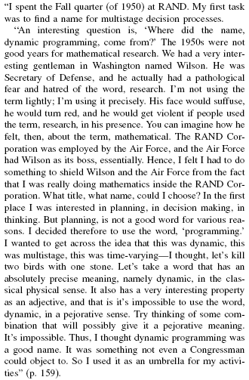
Where did “dynamic programming” come from?
Richard Bellman On the Birth of Dynamic Programming
Stuart Dreyfus
http://www.eng.tau.ac.il/~ami/cd/or50/1526-5463-2002-50-01-0048.pdf

Slide 9
Dynamic programming
Method for solving problems where optimal solutions can be defined in terms of optimal solutions to subproblems
AND
the subproblems are overlapping

Slide 10
Dynamic programming: steps
1a) optimal substructure: optimal solutions to the problem incorporate optimal solutions to related subproblems
convince yourself that there is optimal substructure
1b) recursive definition: use this to recursively define the value of an optimal solution
2) DP solution: describe the dynamic programming table:
size, initial values, order in which it’s filled in, location of solution
3) Analysis: analyze space requirements, running time

Slide 11
LCS problem
Given two sequences X and Y, a common subsequence is a subsequence that occurs in both X and Y
Given two sequences X = x₁, x₂, …, x_{n} and Y = y₁, y₂, …, y_{n}
What is the longest common subsequence?

Slide 12
1b: recursive solution
X = A B C B D A B
Y = B D C A B A
Assume you have a solver for smaller problems

Slide 13
1b: recursive solution
X = A B C B D A ?
Y = B D C A B ?
Is the last character part of the LCS?

Slide 14
1b: recursive solution
X = A B C B D A ?
Y = B D C A B ?
Two cases: either the characters are the same or they’re different

Slide 15
1b: recursive solution
X = A B C B D A A
LCS
The characters are part of the LCS
Y = B D C A B A
What is the recursive relationship?
If they’re the same

Slide 16
1b: recursive solution
X = A B C B D A B
LCS
Y = B D C A B A
If they’re different

Slide 17
1b: recursive solution
X = A B C B D A B
LCS
Y = B D C A B A
If they’re different

Slide 18
1b: recursive solution
X = A B C B D A B
Y = B D C A B A
?
X = A B C B D A B
Y = B D C A B A
If they’re different

Slide 19
1b: recursive solution
X = A B C B D A B
Y = B D C A B A
(for now, let’s just worry about counting the length of the LCS)

Slide 20
2: DP solution
What types of subproblem solutions do we need to store?
LCS(X_{1…j}, Y_{1…k})
two different indices

Slide 21
2: DP solution
What types of subproblem solutions do we need to store?
LCS(X_{1…j}, Y_{1…k})

Slide 22
j
0 1 2 3 4 5 6 y_{j} B D C A B A
i
0 x_{i} 1 A 2 B 3 C 4 B 5 D 6 A 7 B
For Fibonacci and tree counting, we had to initialize some entries in the array. Any here?

Slide 23
j
0 1 2 3 4 5 6 y_{j} B D C A B A
i
0 x_{i} 1 A 2 B 3 C 4 B 5 D 6 A 7 B
0 0 0 0 0 0 0 0 0 0 0 0 0 0
Need to initialize values within 1 smaller in either dimension.

Slide 24
j
0 1 2 3 4 5 6 y_{j} B D C A B A
i
0 x_{i} 1 A 2 B 3 C 4 B 5 D 6 A 7 B
0 0 0 0 0 0 0 0 0 0 0 0 0 0
How should we fill in the table?

Slide 25
j
0 1 2 3 4 5 6 y_{j} B D C A B A
i
0 x_{i} 1 A 2 B 3 C 4 B 5 D 6 A 7 B
0 0 0 0 0 0 0 0 0 0 ? 0 0 0 0
To fill in an entry, we may need to look:
up one
left one
diagonal up and left
Just need to make sure these exist

Slide 26
j
0 1 2 3 4 5 6 y_{j} B D C A B A
i
0 x_{i} 1 A 2 B 3 C 4 B 5 D 6 A 7 B
0 0 0 0 0 0 0 0 ? 0 0 0 0 0 0
LCS(A, B)

Slide 27
j
0 1 2 3 4 5 6 y_{j} B D C A B A
i
0 x_{i} 1 A 2 B 3 C 4 B 5 D 6 A 7 B
0 0 0 0 0 0 0 0 0 0 0 0 0 0 0

Slide 28
j
0 1 2 3 4 5 6 y_{j} B D C A B A
i
0 x_{i} 1 A 2 B 3 C 4 B 5 D 6 A 7 B
0 0 0 0 0 0 0 0 0 0 0 ? 0 0 0 0 0 0
LCS(A, BDCA)

Slide 29
j
0 1 2 3 4 5 6 y_{j} B D C A B A
i
0 x_{i} 1 A 2 B 3 C 4 B 5 D 6 A 7 B
0 0 0 0 0 0 0 0 0 0 0 1 0 0 0 0 0 0
LCS(A, BDCA)

Slide 30
j
0 1 2 3 4 5 6 y_{j} B D C A B A
i
0 x_{i} 1 A 2 B 3 C 4 B 5 D 6 A 7 B
0 0 0 0 0 0 0 0 0 0 0 1 1 1 0 1 1 1 1 2 2 0 1 1 2 2 2 2 0 1 1 2 2 ? 0 0 0
LCS(ABCB, BDCAB)

Slide 31
j
0 1 2 3 4 5 6 y_{j} B D C A B A
i
0 x_{i} 1 A 2 B 3 C 4 B 5 D 6 A 7 B
0 0 0 0 0 0 0 0 0 0 0 1 1 1 0 1 1 1 1 2 2 0 1 1 2 2 2 2 0 1 1 2 2 3 0 0 0
LCS(ABCB, BDCAB)

Slide 32
j
0 1 2 3 4 5 6 y_{j} B D C A B A
i
0 x_{i} 1 A 2 B 3 C 4 B 5 D 6 A 7 B
0 0 0 0 0 0 0 0 0 0 0 1 1 1 0 1 1 1 1 2 2 0 1 1 2 2 2 2 0 1 1 2 2 3 3 0 1 2 2 2 3 3 0 1 2 2 3 3 4 0 1 2 2 3 4 4
Where’s the final answer?

Slide 33
j
0 1 2 3 4 5 6 y_{j} B D C A B A
i
Space requirements?
Running time?
0 x_{i} 1 A 2 B 3 C 4 B 5 D 6 A 7 B
0 0 0 0 0 0 0 0 0 0 0 1 1 1 0 1 1 1 1 2 2 0 1 1 2 2 2 2 0 1 1 2 2 3 3 0 1 2 2 2 3 3 0 1 2 2 3 3 4 0 1 2 2 3 4 4

Slide 34
j
0 1 2 3 4 5 6 y_{j} B D C A B A
i
Space requirements: Θ(nm)
Running time: Θ(nm)
0 x_{i} 1 A 2 B 3 C 4 B 5 D 6 A 7 B
0 0 0 0 0 0 0 0 0 0 0 1 1 1 0 1 1 1 1 2 2 0 1 1 2 2 2 2 0 1 1 2 2 3 3 0 1 2 2 2 3 3 0 1 2 2 3 3 4 0 1 2 2 3 4 4

Slide 35
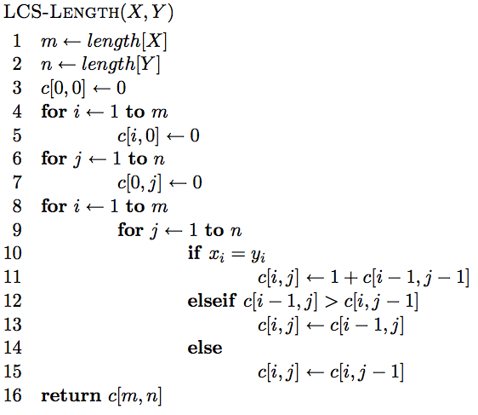
The algorithm

Slide 36
The algorithm
Base case initialization

Slide 37
The algorithm
Fill in the matrix

Slide 38
The algorithm

Slide 39
The algorithm

Slide 40
The algorithm

Slide 41
Keeping track of the solution
Our LCS algorithm only calculated the length of the LCS between X and Y
What if we wanted to know the actual sequence?

Slide 42
j
0 1 2 3 4 5 6 y_{j} B D C A B A
i
0 x_{i} 1 A 2 B 3 C 4 B 5 D 6 A 7 B
0 0 0 0 0 0 0 0 0 0 0 1 1 1 0 1 1 1 1 2 2 0 1 1 2 2 2 2 0 1 1 2 2 ? 0 0 0
LCS(ABCB, BDCAB)

Slide 43
j
0 1 2 3 4 5 6 y_{j} B D C A B A
i
0 x_{i} 1 A 2 B 3 C 4 B 5 D 6 A 7 B
0 0 0 0 0 0 0 0 0 0 0 1 1 1 0 1 1 1 1 2 2 0 1 1 2 2 2 2 0 1 1 2 2 3 0 0 0
LCS(ABCB, BDCAB)

Slide 44
j
0 1 2 3 4 5 6 y_{j} B D C A B A
i
0 x_{i} 1 A 2 B 3 C 4 B 5 D 6 A 7 B
0 0 0 0 0 0 0 0 0 0 0 1 1 1 0 1 1 1 1 2 2 0 1 1 2 2 2 2 0 1 1 2 2 3 ? 0 0 0
LCS(ABCB, BDCABA)

Slide 45
j
0 1 2 3 4 5 6 y_{j} B D C A B A
i
0 x_{i} 1 A 2 B 3 C 4 B 5 D 6 A 7 B
0 0 0 0 0 0 0 0 0 0 0 1 1 1 0 1 1 1 1 2 2 0 1 1 2 2 2 2 0 1 1 2 2 3 3 0 0 0
LCS(ABCB, BDCABA)

Slide 46
j
0 1 2 3 4 5 6 y_{j} B D C A B A
i
0 x_{i} 1 A 2 B 3 C 4 B 5 D 6 A 7 B
0 0 0 0 0 0 0 0 0 0 0 1 1 1 0 1 1 1 1 2 2 0 1 1 2 2 2 2 0 1 1 2 2 3 3 0 1 2 2 2 3 3 0 1 2 2 3 3 4 0 1 2 2 3 4 4
How do we generate the solution from this?

Slide 47
j
0 1 2 3 4 5 6 y_{j} B D C A B A
i
0 x_{i} 1 A 2 B 3 C 4 B 5 D 6 A 7 B
0 0 0 0 0 0 0 0 0 0 0 1 1 1 0 1 1 1 1 2 2 0 1 1 2 2 2 2 0 1 1 2 2 3 3 0 1 2 2 2 3 3 0 1 2 2 3 3 4 0 1 2 2 3 4 4
We can follow the arrows to generate the solution
BCBA

Slide 48
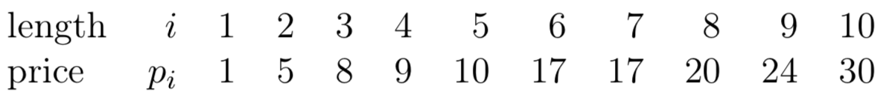
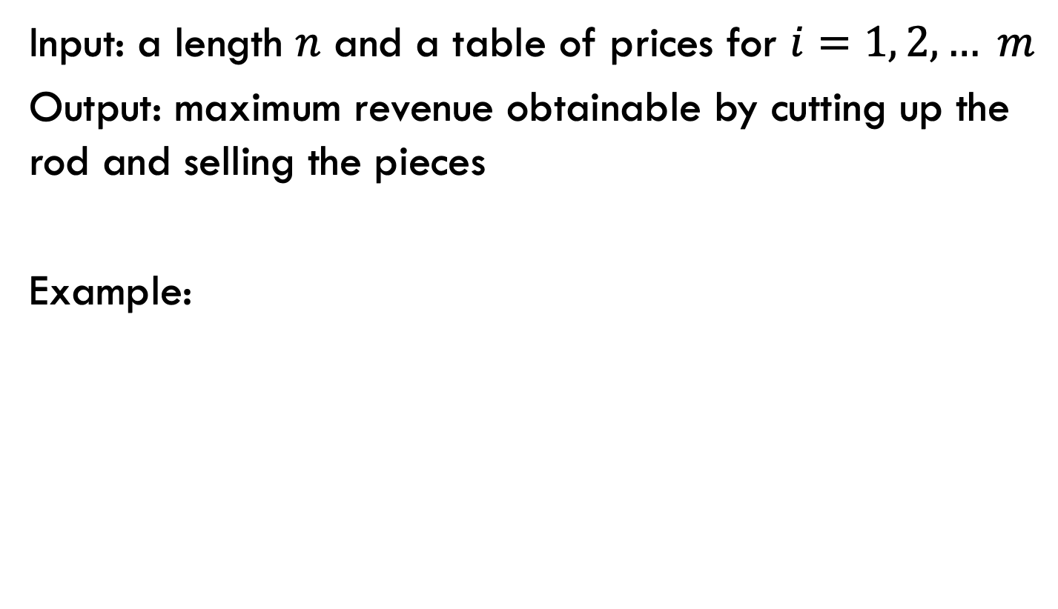
Rod splitting
Input: a length $n$ and a table of prices for $i=1, 2, … m$
Output: maximum revenue obtainable by cutting up the rod and selling the pieces
Example:
3
28

Slide 49
Rod splitting
Input: a length $n$ and a table of prices for $i=1, 2, … m$
Output: maximum revenue obtainable by cutting up the rod and selling the pieces
Example:
3
28
What is the best way if you have 13 units of rod?
Notes:
10 + 3

Slide 50
Rod splitting
Input: a length $n$ and a table of prices for $i=1, 2, … m$
Output: maximum revenue obtainable by cutting up the rod and selling the pieces
Example:
3
28
What is the best way if you have 14 units of rod?
Notes:
6 + 6 + 2

Slide 51
1a: optimal substructure
Prove: optimal solutions to the problem incorporate optimal solutions to related subproblems
3
28
What would a solution look like?

Slide 52
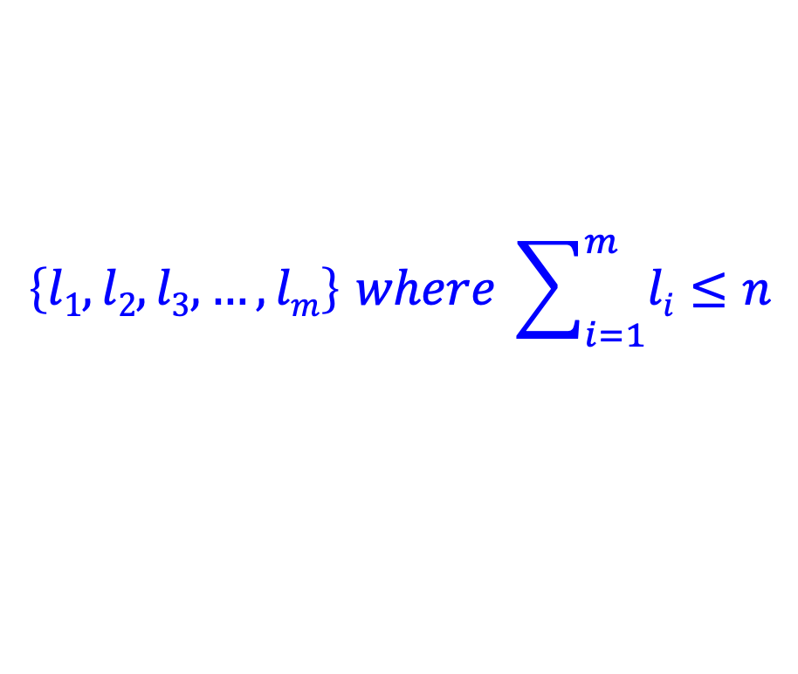
1a: optimal substructure
Prove: optimal solutions to the problem incorporate optimal solutions to related subproblems
3
28
$$\left\{l1, l2, l3, …, lm\right\} where \sum_{i=1}^{m}{li}≤n$$
What would a subproblem solution look like?

Slide 53
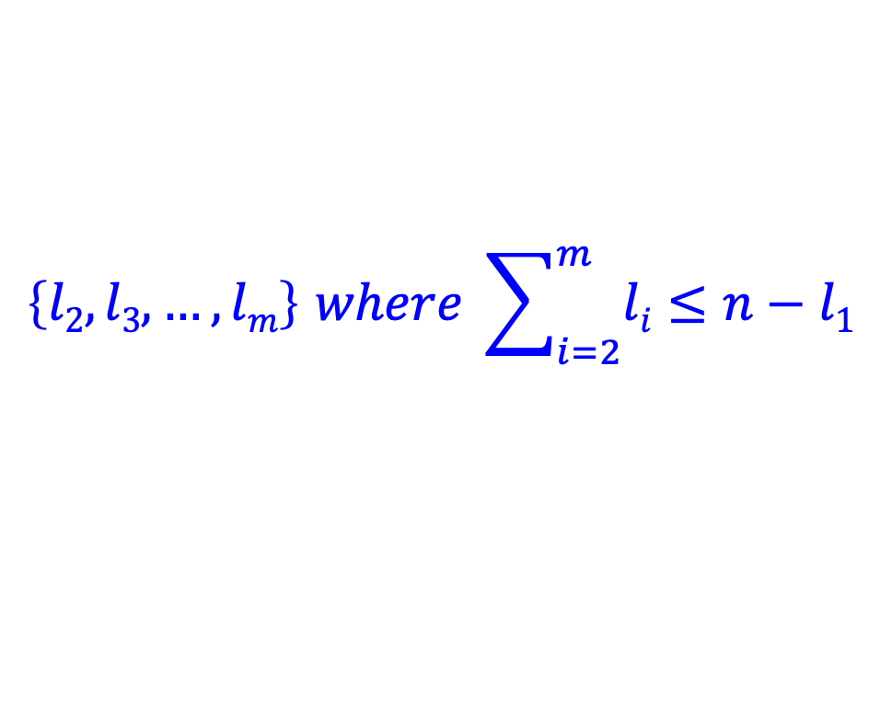
1a: optimal substructure
Prove: optimal solutions to the problem incorporate optimal solutions to related subproblems
3
28
$$\left\{l1, l2, l3, …, lm\right\} where \sum_{i=1}^{m}{li}≤n$$
$$\left\{l2, l3, …, lm\right\} where \sum_{i=2}^{m}{li}≤n−l1$$

Slide 54
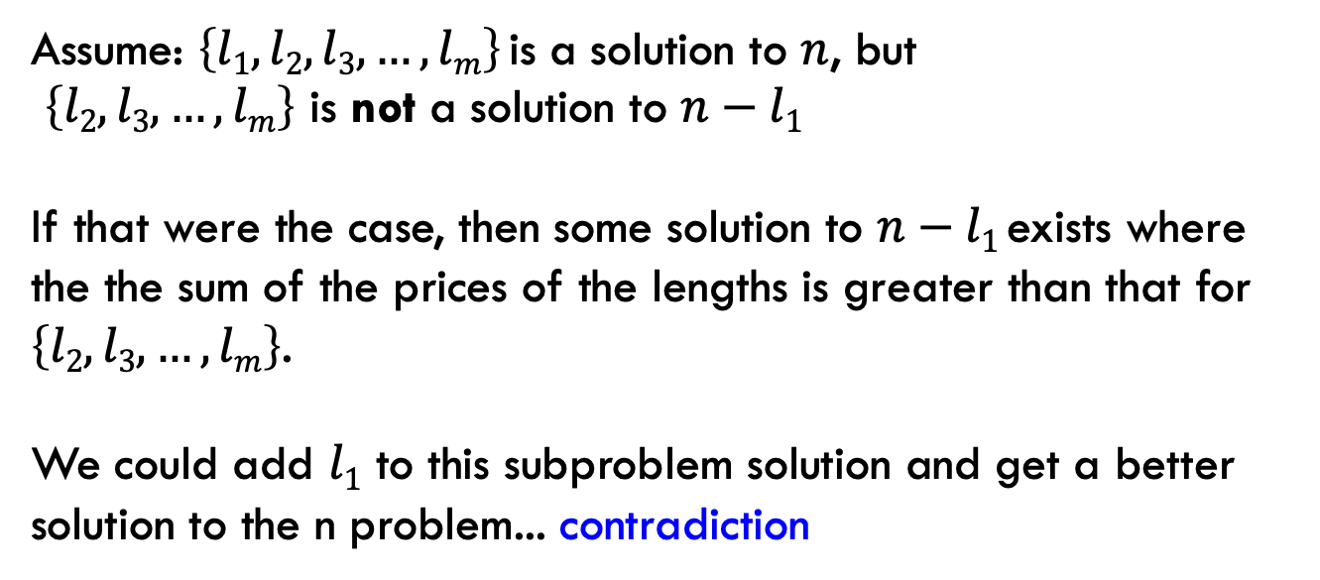
1a: optimal substructure
Prove: optimal solutions to the problem incorporate optimal solutions to related subproblems
Proof by contradiction:
Assume: $\left\{l1, l2, l3, …, lm\right\}$is a solution to $n$, but
$\left\{l2, l3, …, lm\right\}$ is not a solution to $n−l1$
If that were the case, then some solution to $n−l1$exists where the the sum of the prices of the lengths is greater than that for $\left\{l2, l3, …, lm\right\}$.
We could add $l1$ to this subproblem solution and get a better solution to the n problem... contradiction

Slide 55
1b: recursive solution
3
28
n
What should be the first cut?
What are the options?

Slide 56
1b: recursive solution
3
28
n
cut 1
price 1
How much is left?

Slide 57
1b: recursive solution
3
28
n
cut 1
price 1
n-1

Slide 58
1b: recursive solution
3
28
n
cut 2
price 3
n-2

Slide 59
1b: recursive solution
3
28
n
Which one should we choose?
…
Pretend like we have a solver (R) that gives us the answer to sub-problems.
What would R take as input and return?

Slide 60
1b: recursive solution
3
28
n
R(x) → price for best set of cuts of length x
(could structure it with the actual cuts, but focusing on just the price is easier for now)
…

Slide 61
1b: recursive solution
3
28
n
cut 1
price 1
n-1
What’s the best we can do with this cut?

Slide 62
1b: recursive solution
3
28
n
cut 1
price 1
n-1
1 + R(n-1)

Slide 63
1b: recursive solution
3
28
n
cut 2
price 3
n-2
What’s the best we can do with this cut?

Slide 64
1b: recursive solution
3
28
n
cut 2
price 3
n-2
3 + R(n-2)

Slide 65
1b: recursive solution
3
28
n
What should be the first cut?

Slide 66
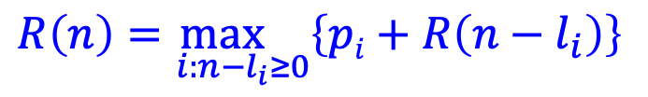
1b: recursive solution
3
28
n
$$R\left(n\right)=\max_{i:n−l_{i}≥0}\left\{pi+R\left(n−l_{i}\right)\right\}$$

Slide 67
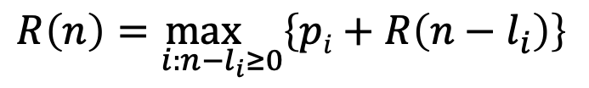
2: DP solution (from the bottom-up)
$$R\left(n\right)=\max_{i:n−l_{i}≥0}\left\{pi+R\left(n−l_{i}\right)\right\}$$
What are the smallest possible subproblems?
To calculate R(n), what are all the subproblems we need to calculate? This is the “table”.
How should we fill in the table?
Where will the answer be?

Slide 68
2: DP solution (from the bottom-up)
$$R\left(n\right)=\max_{i:n−l_{i}≥0}\left\{pi+R\left(n−l_{i}\right)\right\}$$
What are the smallest possible subproblems? R(0) = 0, R(-i) not possible

Slide 69
2: DP solution (from the bottom-up)
$$R\left(n\right)=\max_{i:n−l_{i}≥0}\left\{pi+R\left(n−l_{i}\right)\right\}$$
To calculate R(n), what are all the subproblems we need to calculate? This is the “table”. R(0)…R(n)
Note: This is filling in a table for all possible integer lengths from 1 to n.

Slide 70
2: DP solution (from the bottom-up)
$$R\left(n\right)=\max_{i:n−l_{i}≥0}\left\{pi+R\left(n−l_{i}\right)\right\}$$
How should we fill in the table?
R(0) → R(n)
The dependencies are on smaller values

Slide 71
2: DP solution (from the bottom-up)
$$R\left(n\right)=\max_{i:n−l_{i}≥0}\left\{pi+R\left(n−l_{i}\right)\right\}$$
Where will the answer be?
R(n)

Slide 72
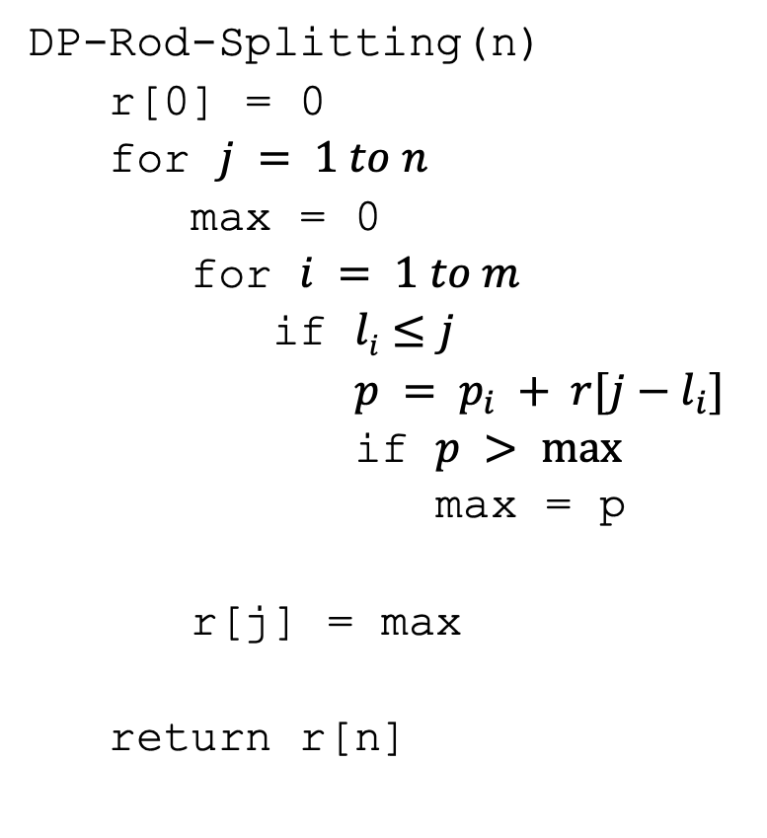
2: DP solution
DP-Rod-Splitting(n)
r[0] = 0
for $j = 1 to n$
max = 0
for $i = 1 to m$
if $li≤j$
$p = p_{i} + r[j−l_{i}]$
if $p > max⁡$
max = p
r[j] = max
return r[n]

Slide 73
2: DP solution
DP-Rod-Splitting(n)
r[0] = 0
for $j = 1 to n$
max = 0
for $i = 1 to m$
if $li≤j$
$p = p_{i} + r[j−l_{i}]$
if $p > max⁡$
max = p
r[j] = max
return r[n]
Space requirements?
Running time?

Slide 74
2: DP solution
DP-Rod-Splitting(n)
r[0] = 0
for $j = 1 to n$
max = 0
for $i = 1 to m$
if $li≤j$
$p = p_{i} + r[j−l_{i}]$
if $p > max⁡$
max = p
r[j] = max
return r[n]
Space requirements: Θ(n)
Running time: Θ(nm)

Slide 75
2: DP solution
DP-Rod-Splitting(n)
r[0] = 0
for $j = 1 to n$
max = 0
for $i = 1 to m$
if $li≤j$
$p = p_{i} + r[j−l_{i}]$
if $p > max⁡$
max = p
r[j] = max
return r[n]
What if you want to know the cuts?

Slide 76
0-1 Knapsack problem
0-1 Knapsack – A thief robbing a store finds m items worth v₁, v₂, .., v_{m} dollars and weight w₁, w₂, …, w_{m} pounds, where v_{i} and w_{i} are integers. The thief can carry at most W pounds in the knapsack. Which items should the thief take if they want to maximize value?
Repetition is allowed, that is you can take multiple copies of any item

Slide 77
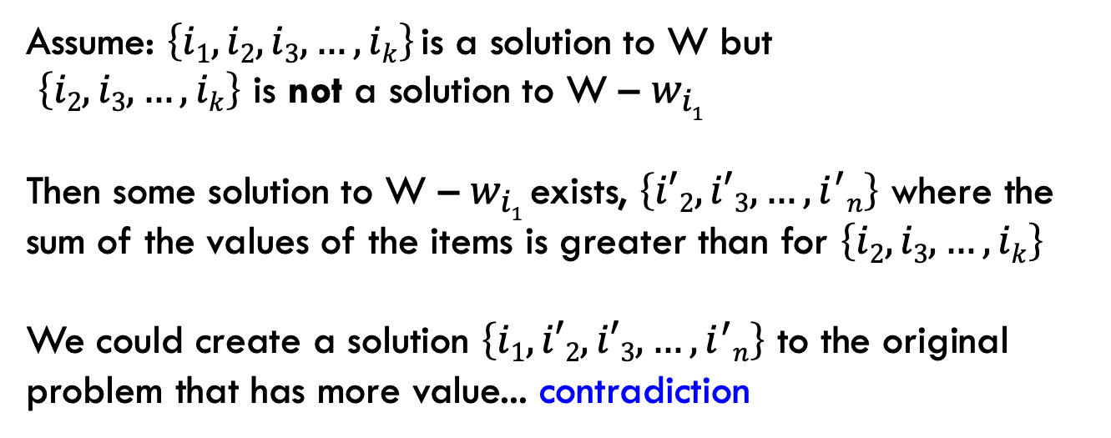
1a: optimal substructure
Prove: optimal solutions to the problem incorporate optimal solutions to related subproblems
Proof by contradiction:
Assume: $\left\{i1, i2,i3, …, ik\right\}$is a solution to W but
$\left\{i2, i3, …, ik\right\}$ is not a solution to W – $w_{i1}$
Then some solution to W – $w_{i1}$exists, $\left\{i′2, i′3, …, i^{′}n\right\}$ where the sum of the values of the items is greater than for $\left\{i2, i3, …, ik\right\}$
We could create a solution $\left\{i1,i′2, i′3, …, i^{′}n\right\}$ to the original problem that has more value... contradiction

Slide 78
1b: recursive solution

Slide 79
2: DP solution (from the bottom-up)
What are the smallest possible subproblems? K(0) = 0
To calculate K(w), what are all the subproblems we need to calculate? This is the “table”. K(0) … K(W)
How should we fill in the table? K(1) → K(W)
Where will the answer be? K(W)

Slide 80
3: Analysis
What are the smallest possible subproblems? K(0) = 0
To calculate K(w), what are all the subproblems we need to calculate? This is the “table”. K(0) … K(W)
How should we fill in the table? K(0) → K(W)
Where will the answer be? K(W)
Space requirements: Θ(W)
Running time: Θ(Wm)

Slide 81
Memoization
Sometimes it can be a challenge to write the function in a bottom-up fashion
Memoization:
Write the recursive function top-down
Alter the function to check if we’ve already calculated the value
If so, use the pre-calculate value
If not, do the recursive call(s)

Slide 82
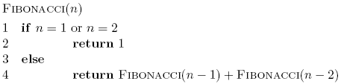
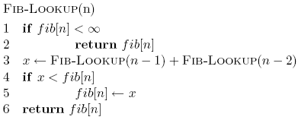
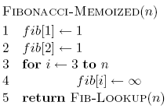
Memoized fibonacci

Slide 83
Memoized fibonacci
Use ∞ to denote uncalculated

Slide 84
Memoized fibonacci
What else could we use besides an array?
Use ∞ to denote uncalculated

Slide 85
Memoized fibonacci
Check if we already calculated the value

Slide 86
Memoized fibonacci
calculate the value

Slide 87
Memoized fibonacci
store the value

Slide 88
Memoization
Pros
Can be more intuitive to code/understand
Can be memory savings if you don’t need answers to all subproblems
Cons
Depending on implementation, larger overhead because of recursion (though often the functions are tail recursive)

